Slide 1
CUSTOMER RETENTION PROJECT
Submitted by: Twinkle Patel

Slide 2
INTRODUCTION
A customer receives/buys products and services, and can buy different services and products from different suppliers.The main goal of all business enterprises is to attract customers and try to make them purchase what they have on sale. They also try to attract them to keep coming back. Merchants main point of marketing is having an understanding of what the customer needs and trending. When a customer buys something, the seller immediately focuses on the next customers. If sellers provide good services and make customers happy then customers always buy next time from those sellers.
Nowadays we see growing companies are always trying to attack with their good services. and this is possible because of internet and online businesses. As we know that online sellers are trying to make a good impression with all their customers and who are buying a good from their.And sellers always ask feedback from receivers so next customers and sellers get reviews and they can track the value /quality /services how receivers get.
Online sellers/traders do this so customers can improve their purchasing experience from there. Sellers are make great efforts on offers on customers preferences

Slide 3
PROBLEM STATEMENT
Customer satisfaction has emerged as one of the most important factors that guarantee the success of online stores; it has been posited as a key stimulant of purchase, repurchase intentions and customer loyalty. A comprehensive review of the literature, theories and models have been carried out to propose the models for customer activation and customer retention. Five major factors that contributed to the success of an e-commerce store have been identified as: service quality, system quality, information quality, trust and net benefit. The research furthermore investigated the factors that influence the online customers' repeat purchase intention. The combination of both utilitarian value and hedonistic values are needed to affect the repeat purchase intention (loyalty) positively. The data is collected from the Indian online shoppers. Results indicate the e-retail success factors, which are very much critical for customer satisfaction.

Slide 4
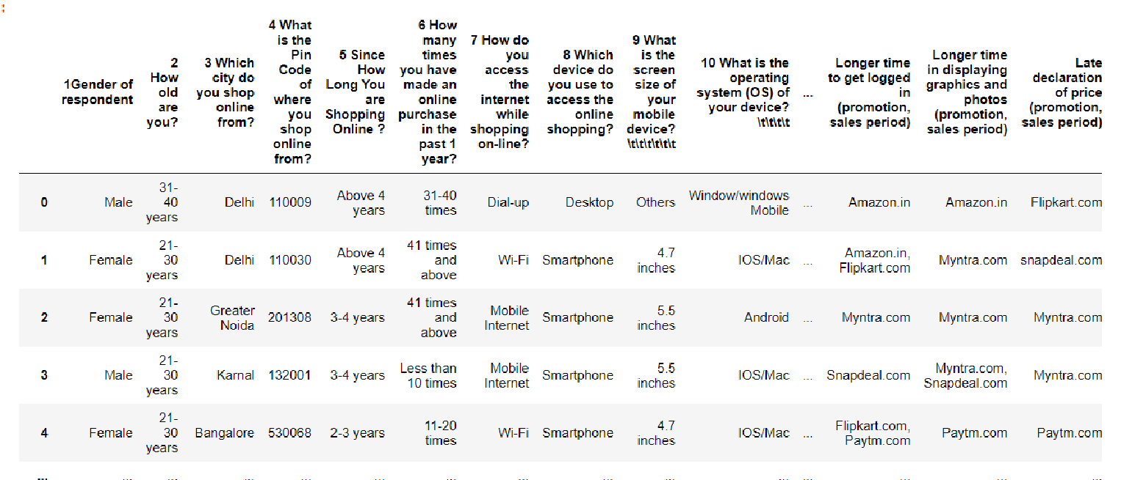
ANALYTICAL DATA ANALYSIS
The sample data for the reference is as shown below:

Slide 5
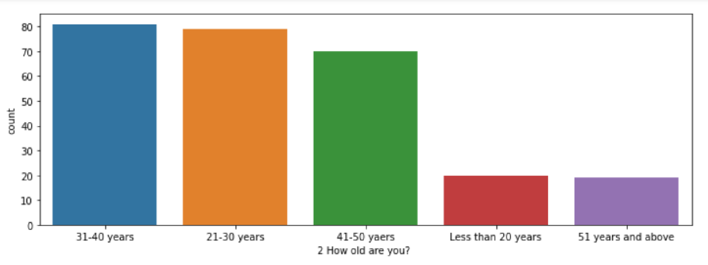
Age group of the customers: .As we shown below from graph group of 31-40 and 21-30 years are customers are highly active in online shopping .

Slide 6
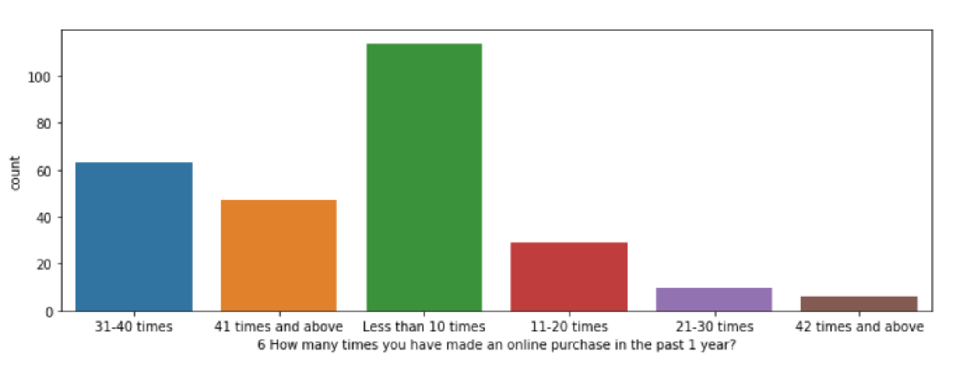
• Number of times shopping has been made in past one year: Highest number of people shopped online less than 10 times in the past one year.

Slide 7
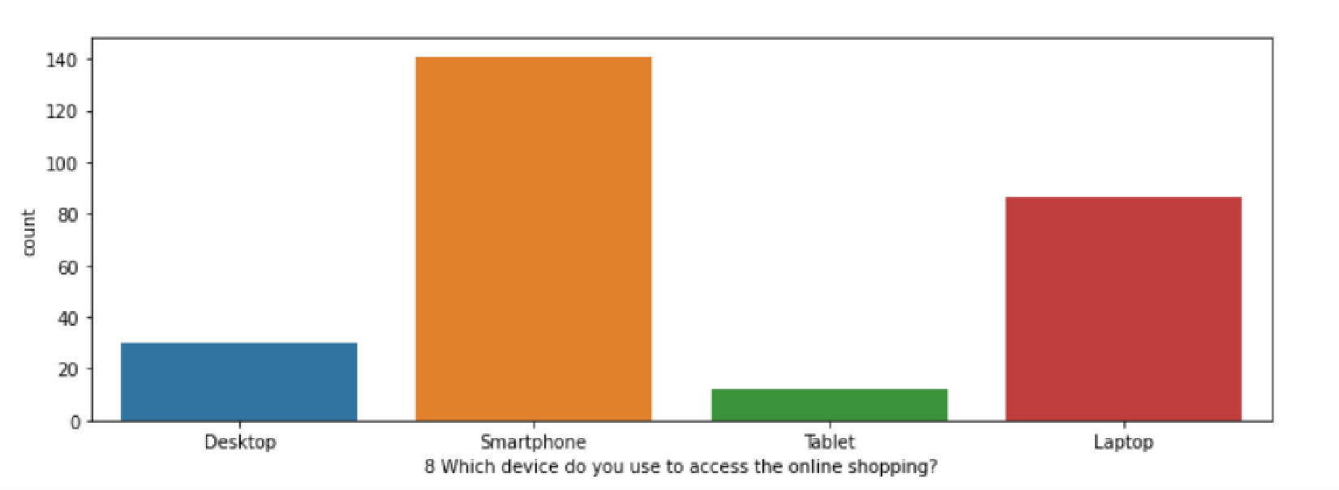
People are using smartphone device more than other system for shopping

Slide 8
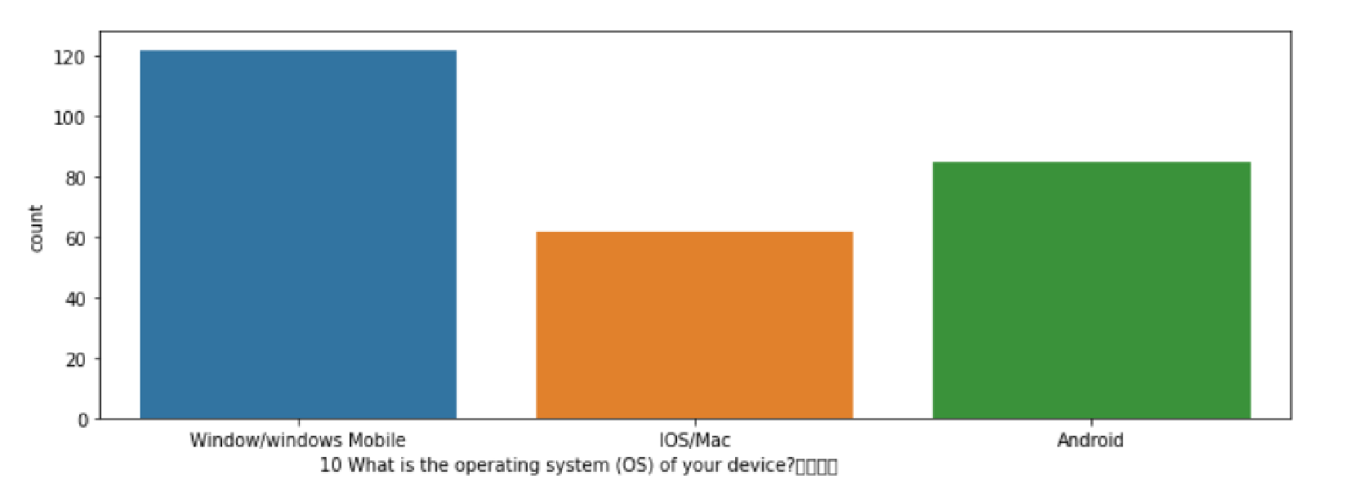
Window operating system users are two times more than IOS/Mac.

Slide 9
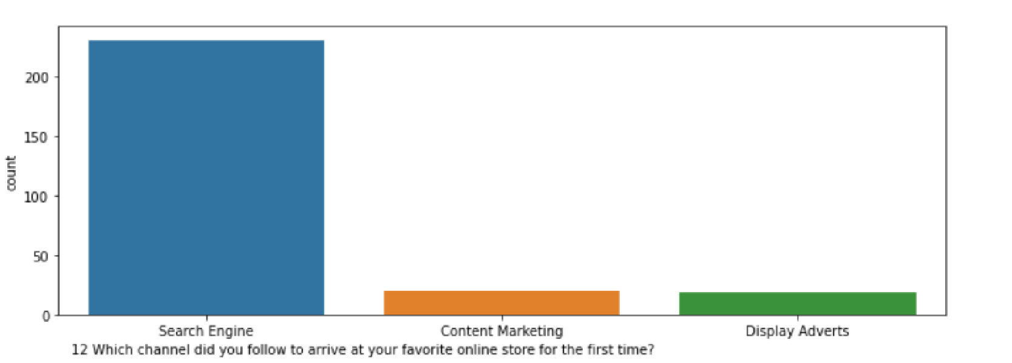
As per below graph we can see it Most of Buyers are use search engine like goggle and mozilla for what they want services and products

Slide 10
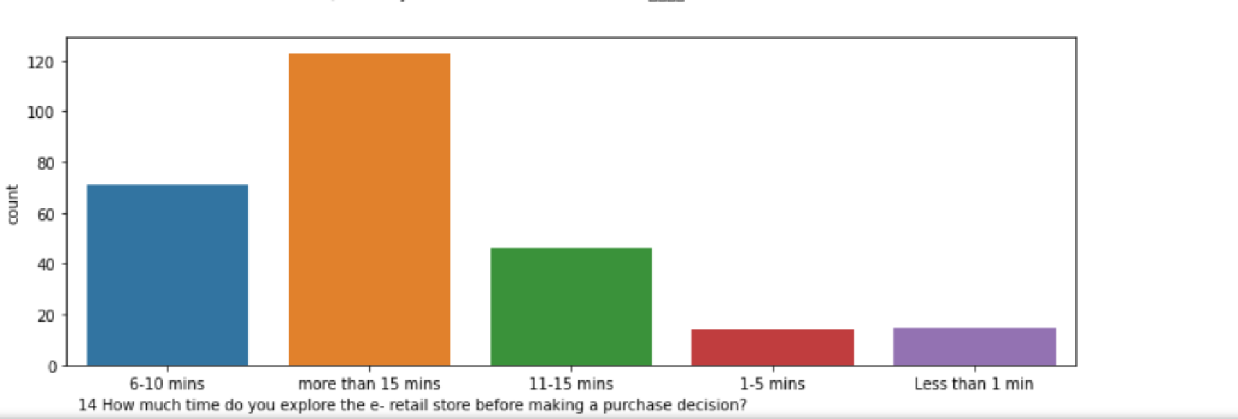
As per below graph mention that how much time buyer spend on e-retail store.

Slide 11
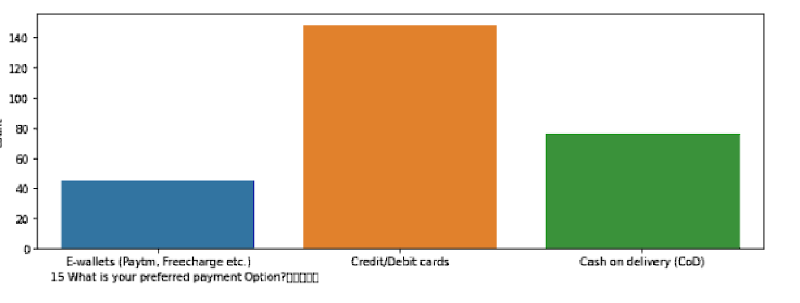
As we seen below that customers use online payment via credit/debit card 2 times more than cash on delivery

Slide 12
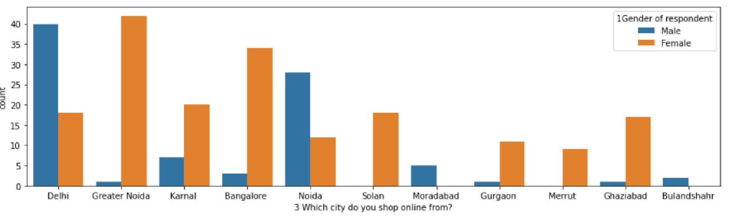
Now we can see below relation between male and female
- As we can see from the graph, male in Delhi and Noida buy products online more than females and as per the data for other graphs female buyers are more than for others.

Slide 13
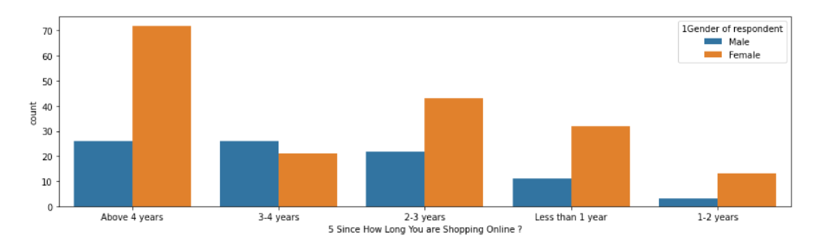
From the below data show how long girls and boys purchase from the last 5 years.

Slide 14
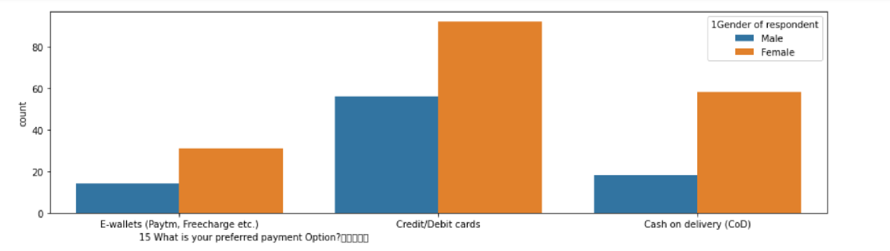
Below notice that male users have always less interest on E-wallet and cash on delivery.

Slide 15
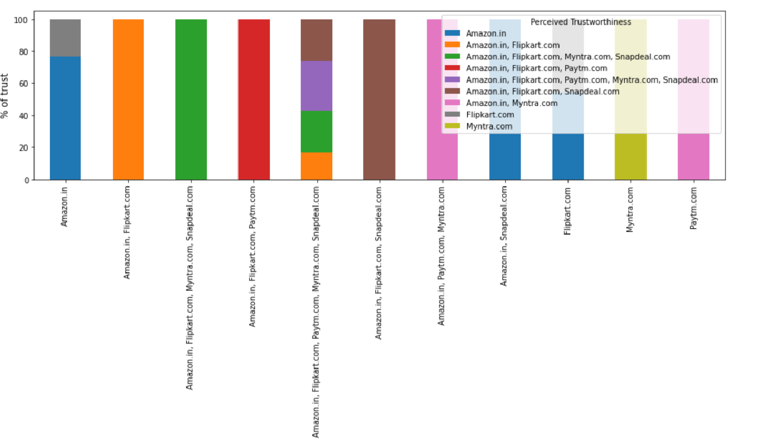
Perceived trustworthiness: The most trusted online shopping site by the customers

Slide 16
Conclusion
There are many ways to improve customer experience and customer satisfaction. Companies can provide good services so customers can repeat purchases and brand loyalty. The first includes taking what customers feel after purchasing products and services. Companies have received feedback from existing customers, through a satisfaction survey or other customer engagement, and putting it into action.
New customers find it a lot harder to trust your company for the first time because they don't have practically experienced what kind of value gain you provide. That’s why it’s even more important to provide a positive customer experience to meet up with customer expectations and best service so that the help of your customers' positive experience can help your businesses succeed. By focusing on customer delight and meeting up with customer expectations, you can get more business from them and acquire new clients when they refer your business to their friends ,family, etc. So retaining customers by focusing on a solid customer retention strategy opens up unseen opportunities for new customer acquisition as well.

